Slide 1
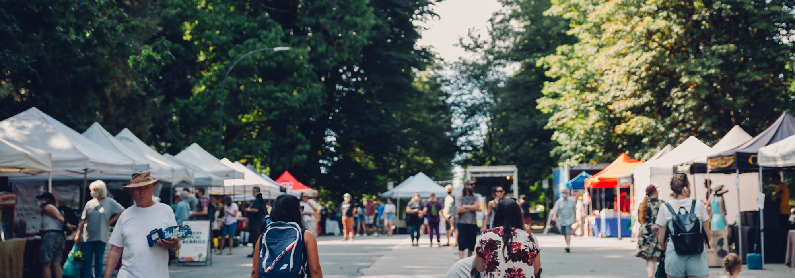
2025 Launch and Orientation
FMNCP Team
May and June, 2025
Photo Credit: New Westminster Farmers Market & Johann Vincent
Notes:
Thank the host (if hosted)

Slide 2
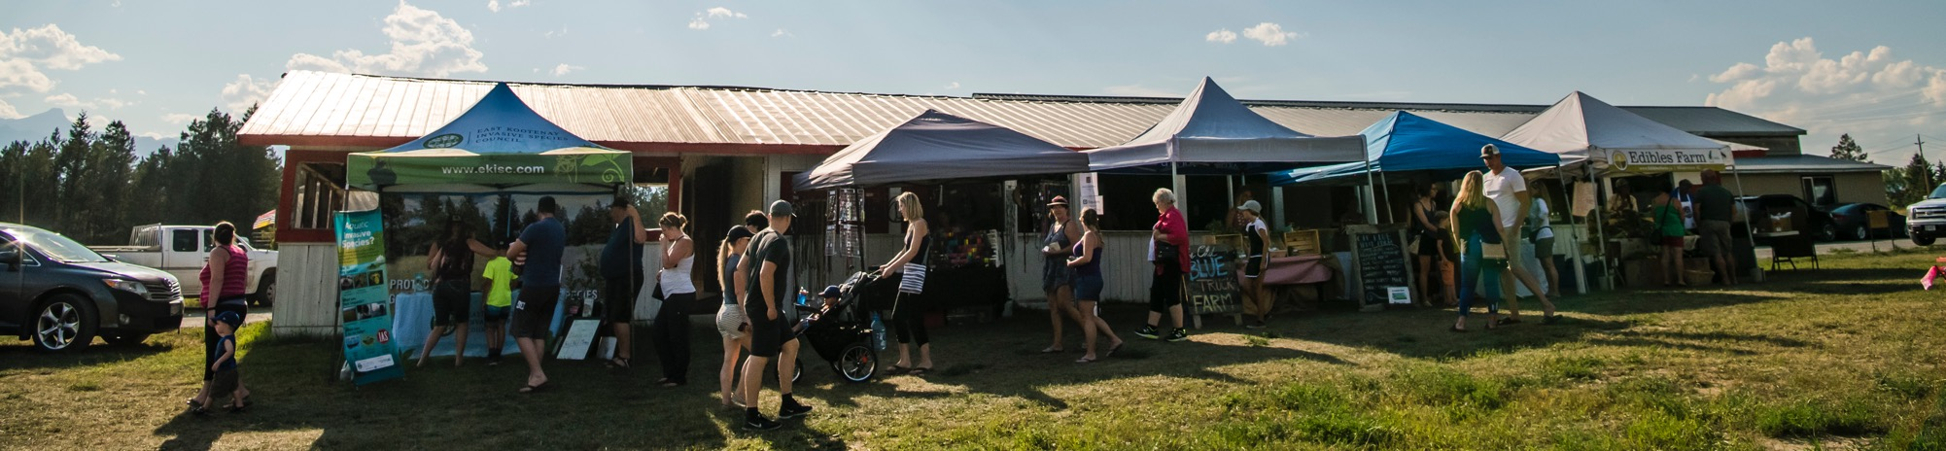
BC Farmers’ Markets acknowledges that we and our members largely operate on unceded Indigenous territories across the land now known as British Columbia. As an organization and individually, we are committed to understanding the ongoing impact of Canada's colonial past and present, and building relationships with Indigenous peoples to foster an inclusive community for current and future generations.
Agri Park Farmers Market & Bruno Long

Slide 3
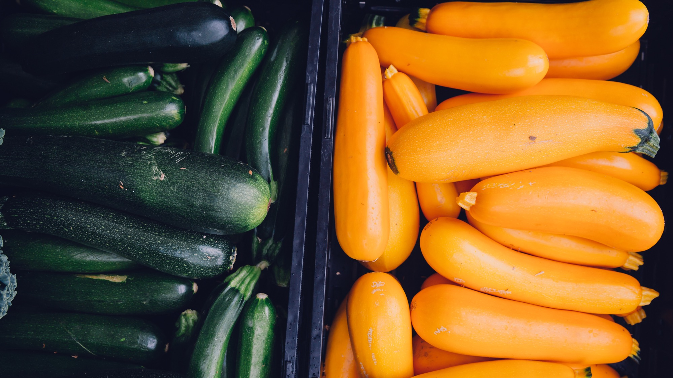

Mission
Our mission is to support, develop and promote farmers' markets in BC
Our Guiding Principles
Resiliency
Connection
Innovation
Equity, Social Justice & Decolonization
Empowerment
Joy & Celebration
Burnaby Artisan Farmers Market & Johann Vincent

Slide 4
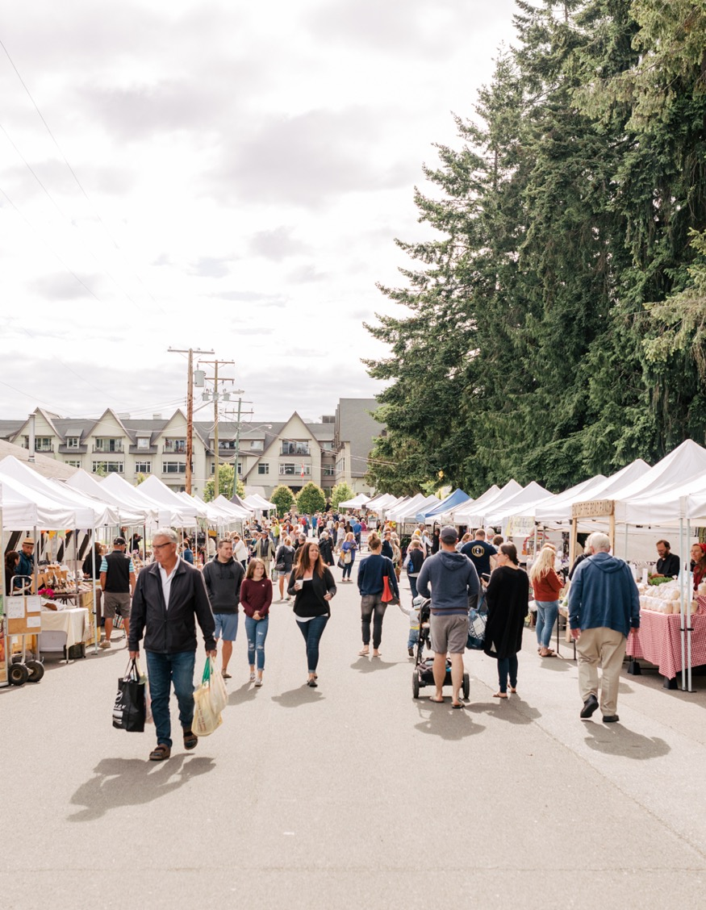

Founded in 2000, BC Association of Farmers’ Markets (BCAFM) is a member based non-profit organization which supports and promotes 145+ member farmers’ markets in all regions of British Columbia so local food continues to thrive.
Credit: BC Farmers’ Market Trail & Jordan Dyck

Slide 5
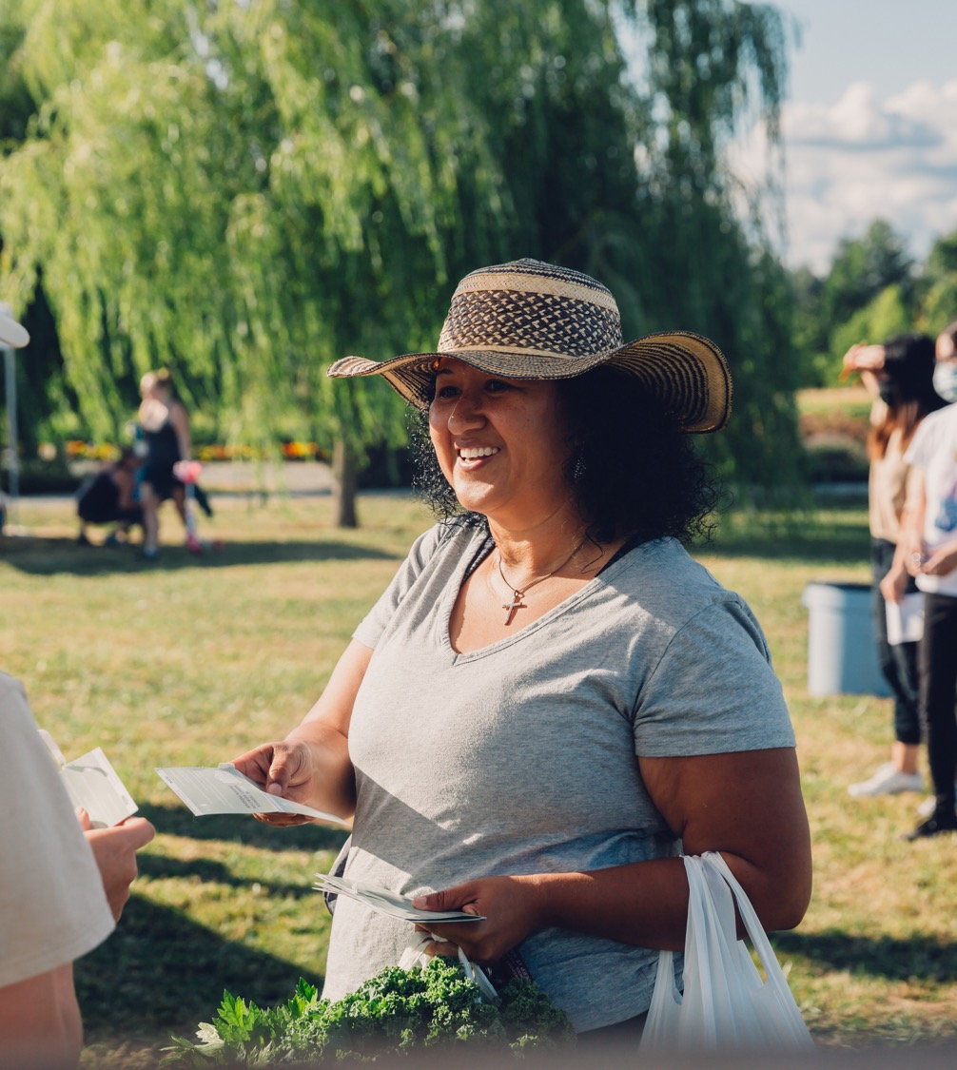
Agenda
Welcome and Introductions
About the FMNCP Program
Administering the FMNCP Program
What’s New in ‘25
Selecting Participants
Networking
Tools and Resources
Get Your Materials
Langley Community Farmers Market & Johann Vincent

Slide 6
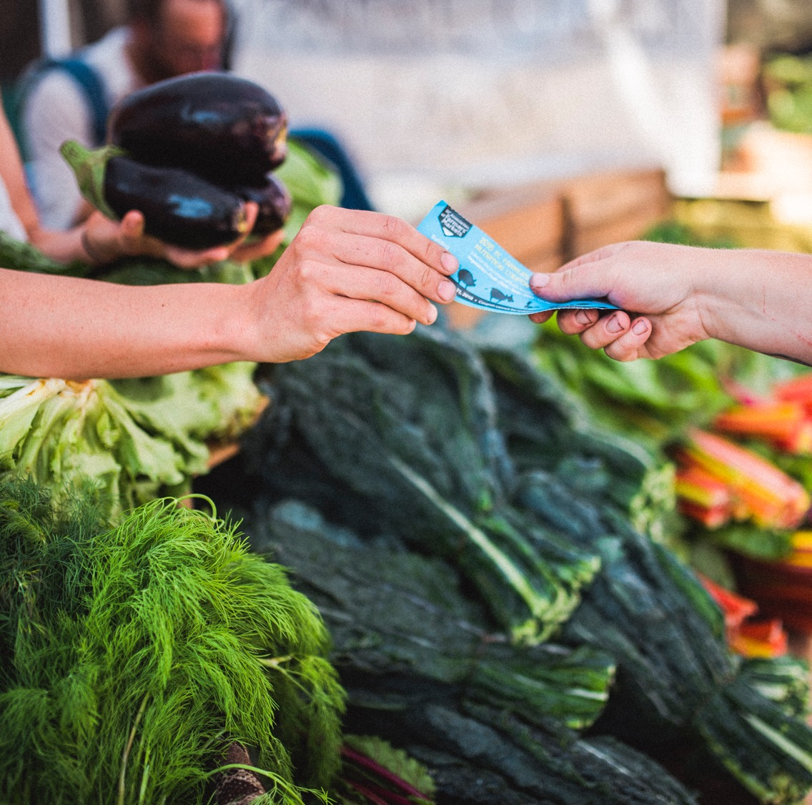
About
Farmers’ Market Nutrition Coupon Program
Nelson Farmers Market & Thomas Nowaczynski

Slide 7
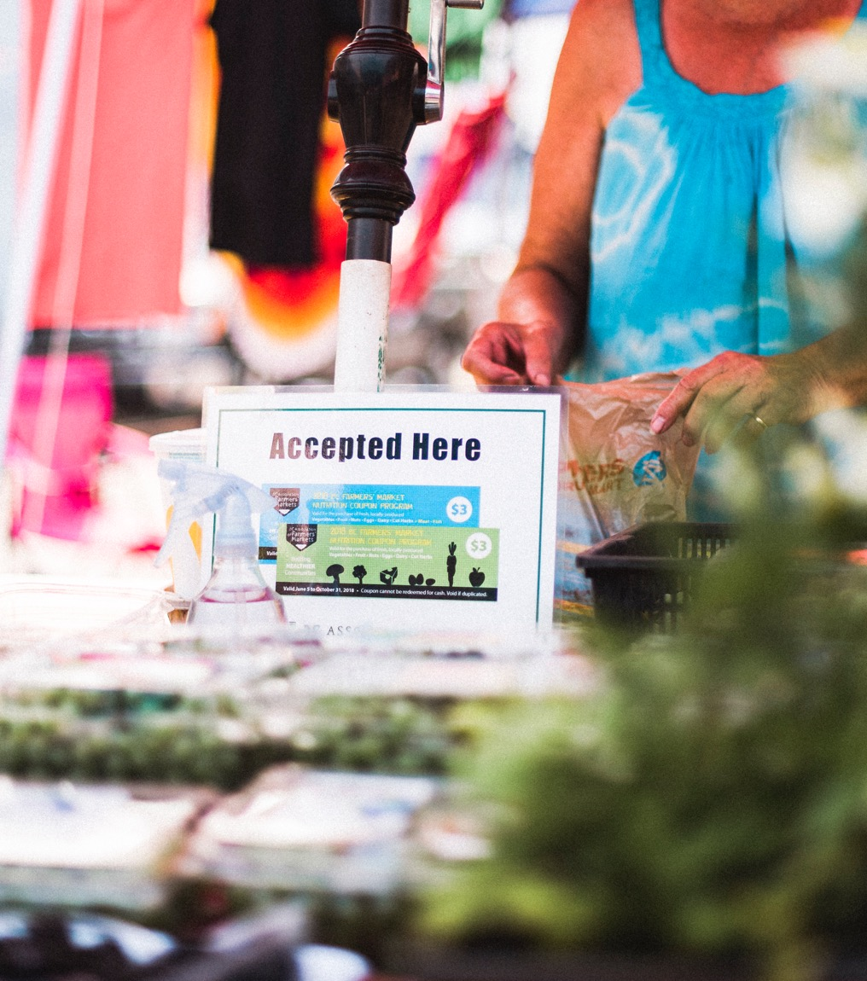
FMNCP Objectives
Increase access to healthy local food for lower-income pregnant people, families with children and seniors/elders
To improve the health of lower-income British Columbians
Trails Incredible Farmers Market & Thomas Nowaczynski
Credit: BC Farmers’ Market Trail & Nathaniel Martin

Slide 8
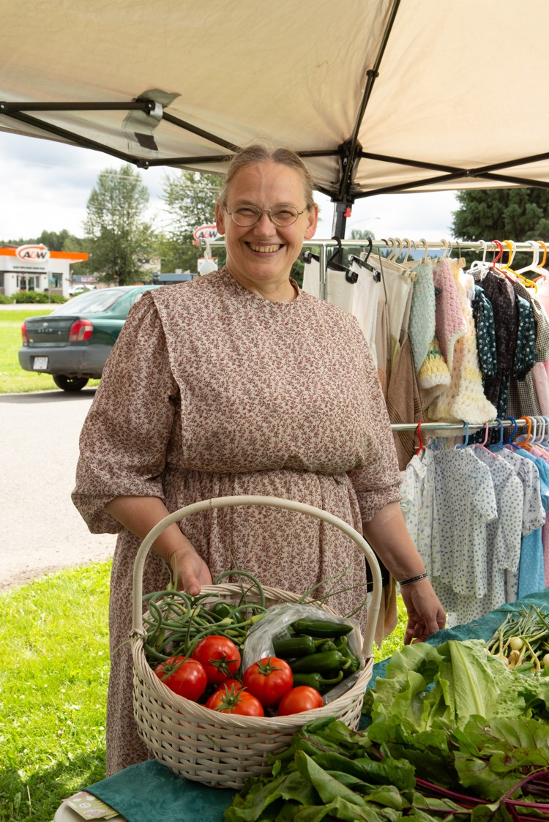
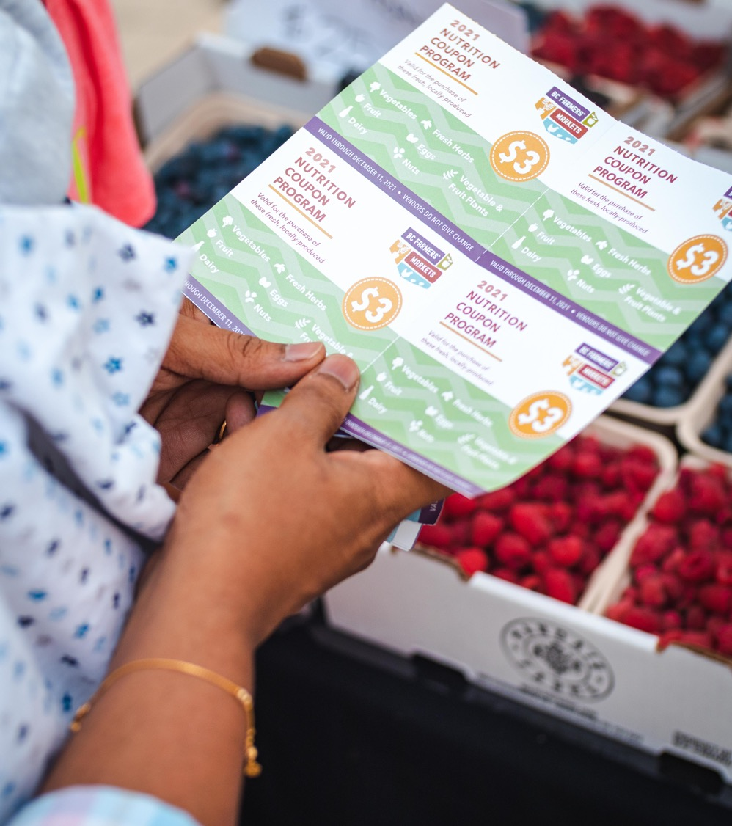
FMNCP Objectives
  To improve the economic prosperity of British Columbia farmers who sell at BC farmers’ markets.
Downtown Vancouver Farmers Market & Jasmine Noble

Slide 9
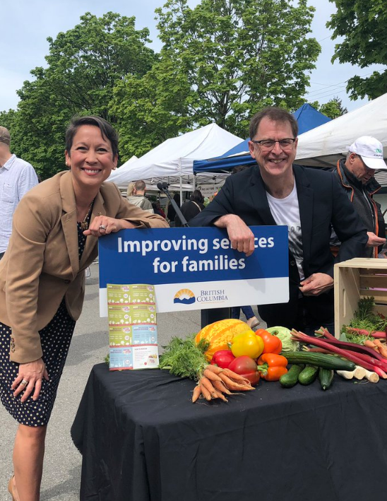
Supported by the Province of British Columbia

Slide 10

2025 Timeline
First Day:
Friday, June 20
Last Day:
Sunday, Dec 21
16 weeks of sheets
Up to 27 weeks to redeem

Slide 11
2025 Coupons

Slide 12
Additional Versions
← Feeding Futures
CIHR Study →

Slide 13
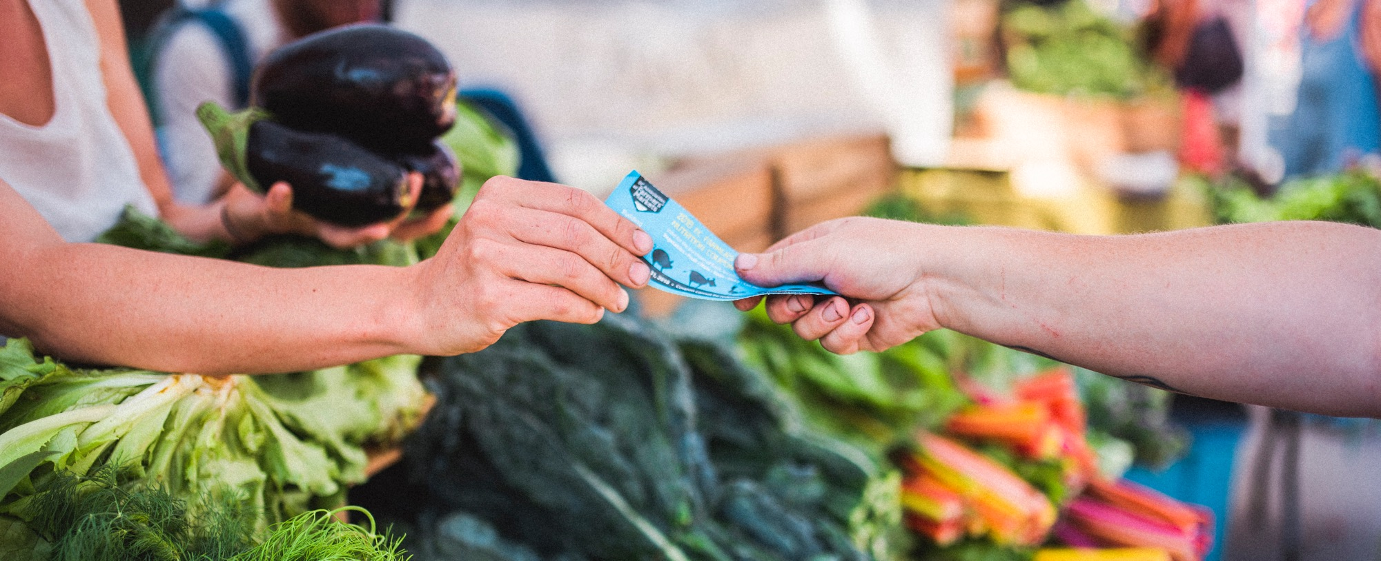
Administering the Farmers’ Market Nutrition Coupon Program
Credit: BC Farmers’ Market Trail & Thomas Nowaczynski

Slide 14
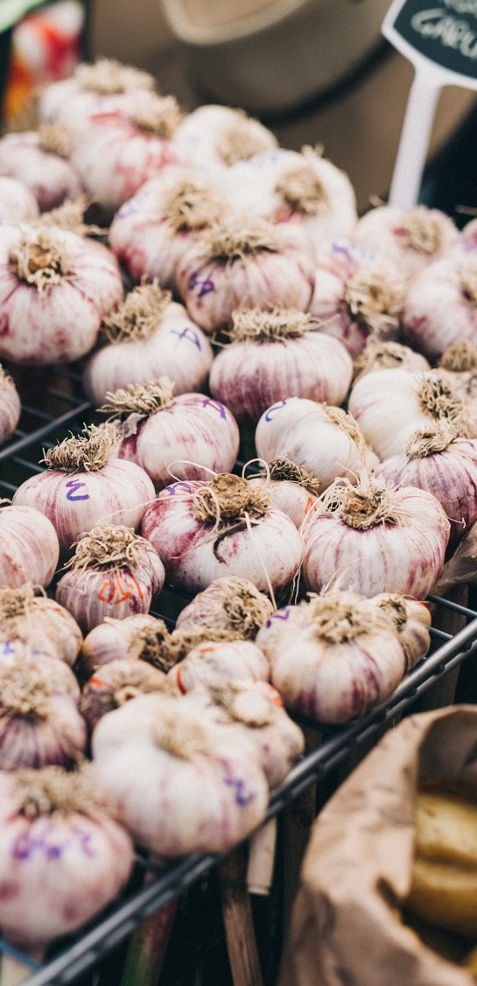
Topics
Farmers Markets Administration
Community Partner Administration
Reporting
Tools & Resources
Credit: BC Farmers’ Market Trail & Nathaniel Martin

Slide 15
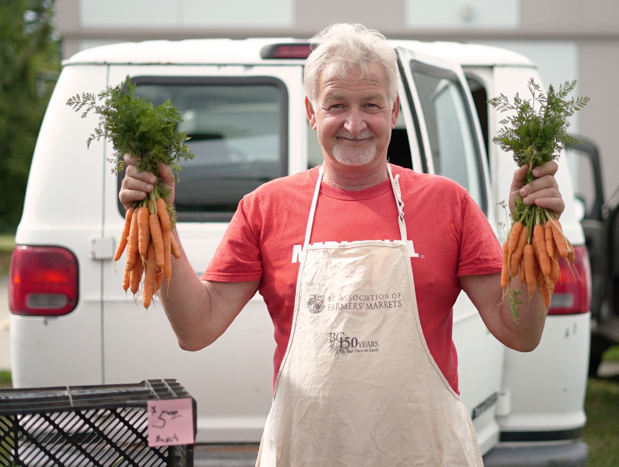
What You Do
FARMERS MARKET
Credit: BC Farmers’ Market Trail & Jess Clark

Slide 16
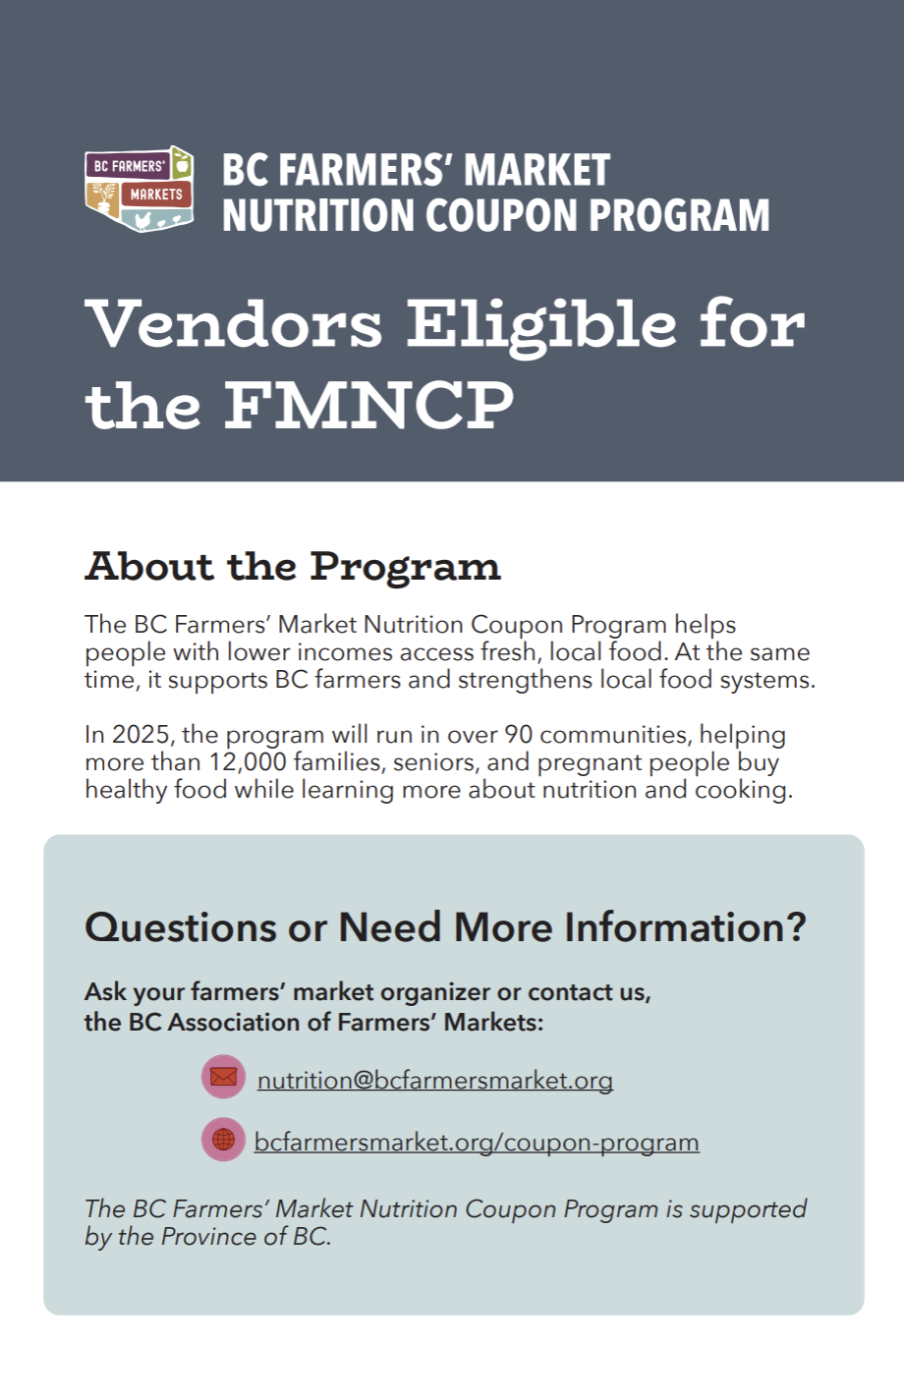
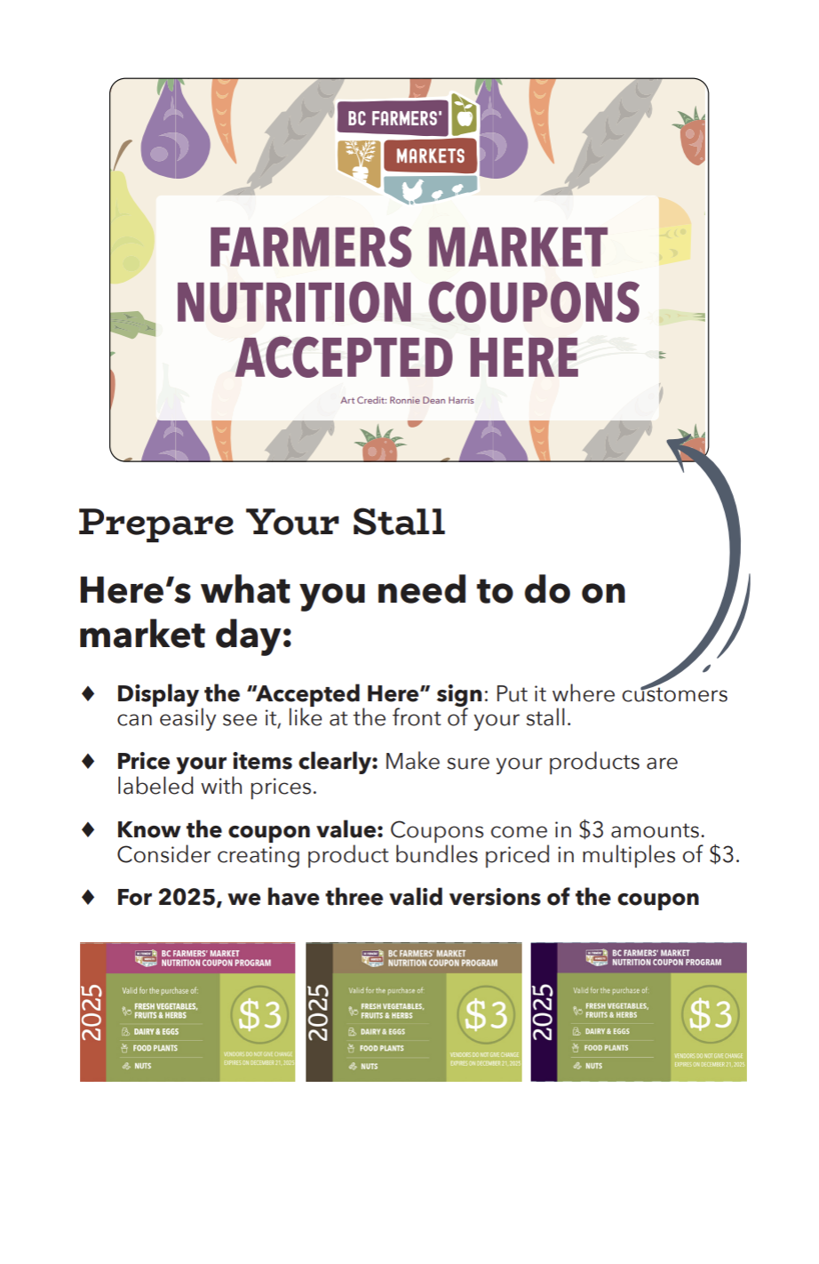
FARMERS MARKET
Give Vendors (who accept coupons) this brochure:
Credit: BC Farmers’ Market Trail & Jess Clark

Slide 17
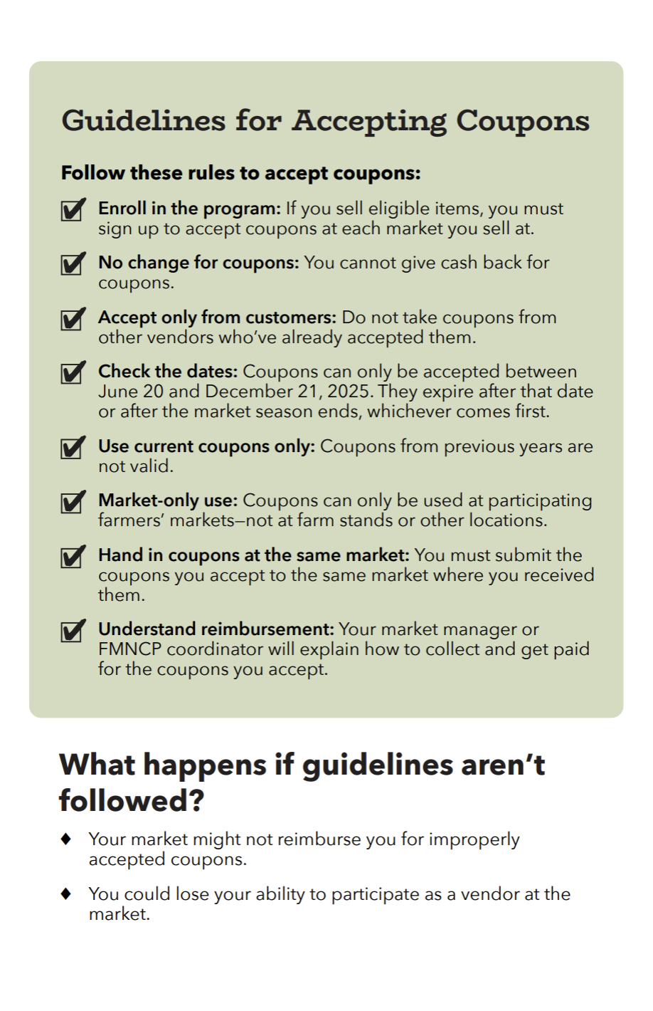
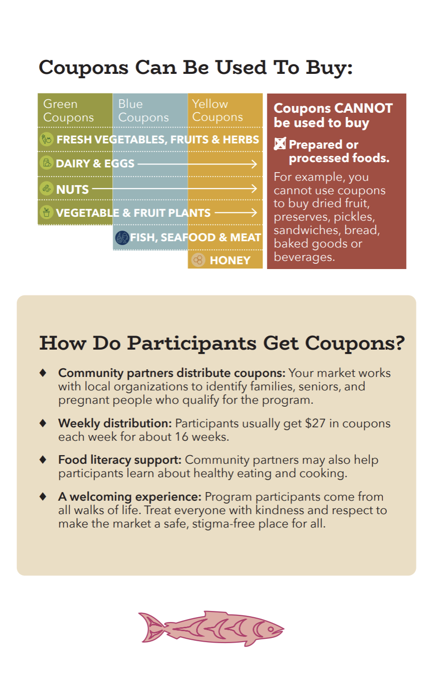
FARMERS MARKET
Give Vendors (who accept coupons) this brochure:
Credit: BC Farmers’ Market Trail & Jess Clark

Slide 18
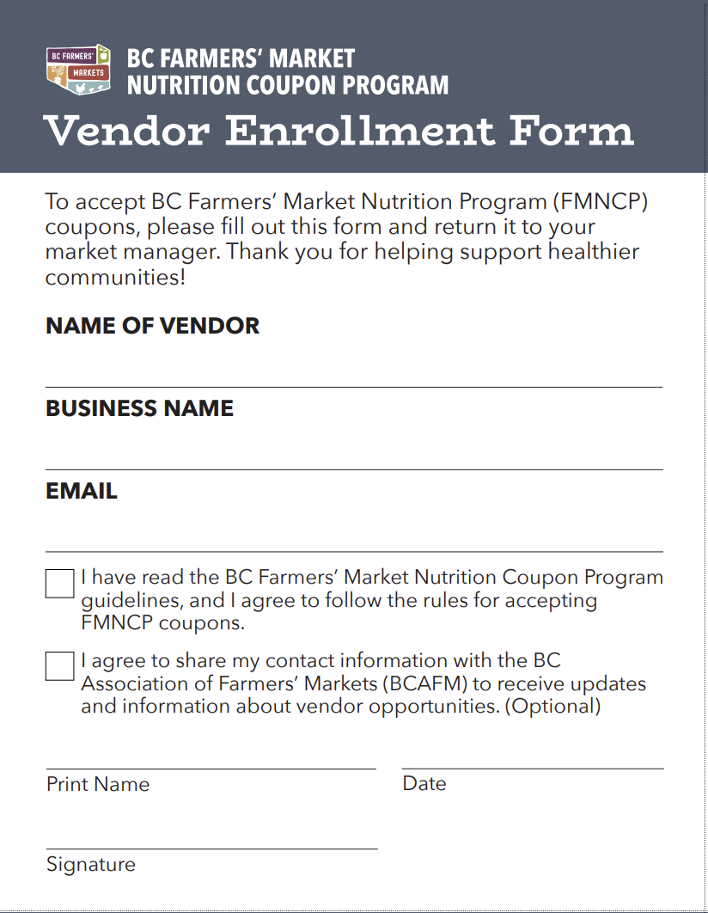
Enroll vendors.
At every farmers market attend.
FARMERS MARKET
FARMERS MARKET
Notes:
All vendor must accept coupons. Not optional. All must complete enrollment form. Only then can you mete out punishment/consquences

Slide 19
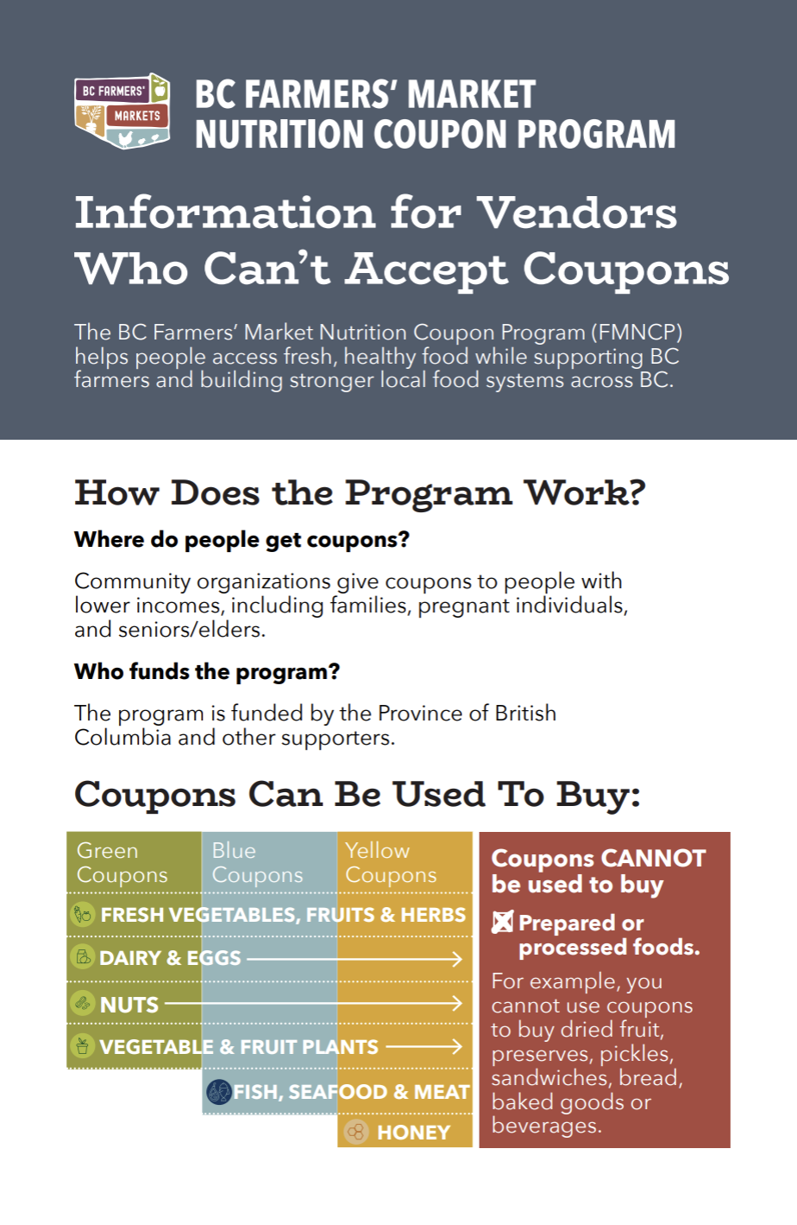
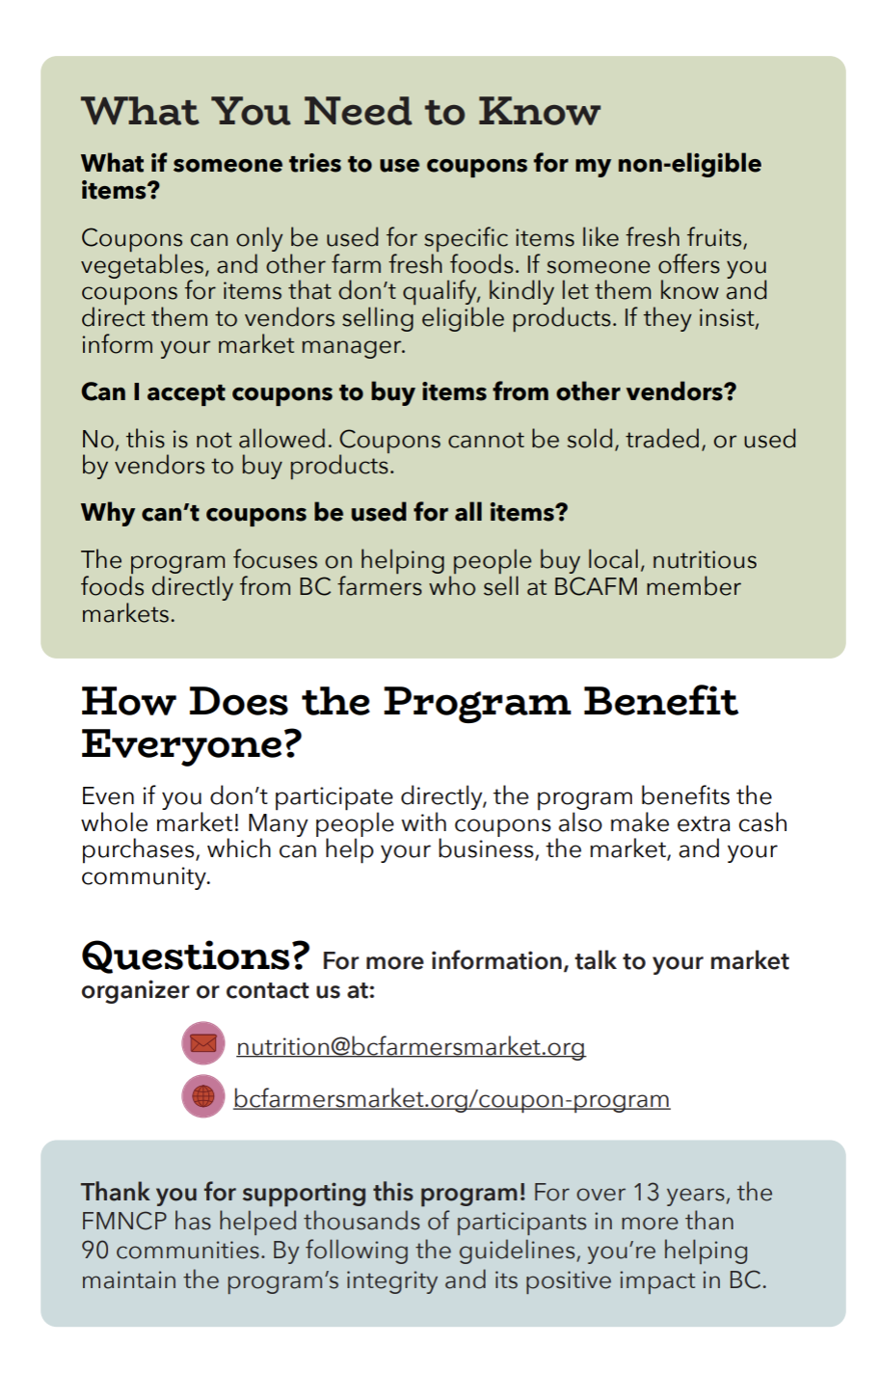
FARMERS MARKET
What about the other vendors at your market?
Give them this brochure.
Credit: BC Farmers’ Market Trail & Jess Clark
Notes:
Include some ”off the rails stories about vendor shenanigans”

Slide 20

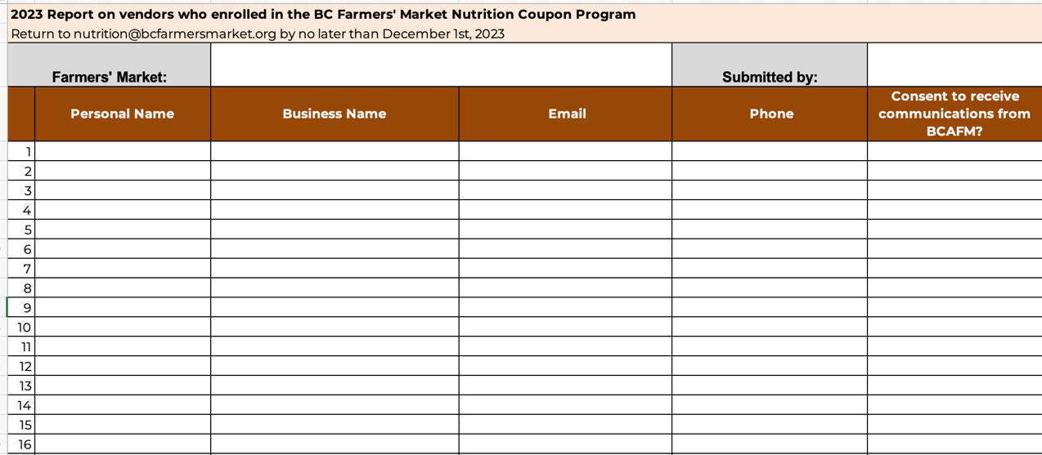
3. Report to BCAFM – at the end of your season
FARMERS MARKET
Credit: BC Farmers’ Market Trail & Jess Clark

Slide 21
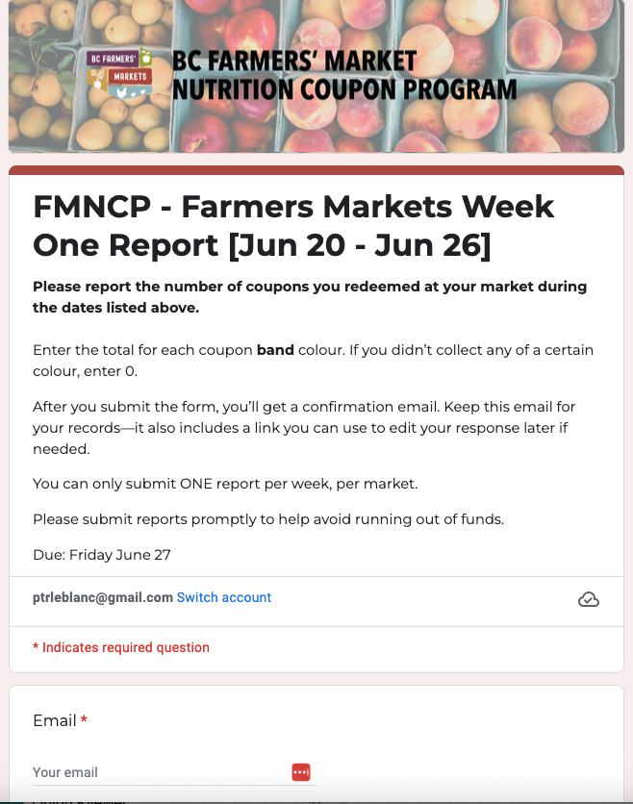
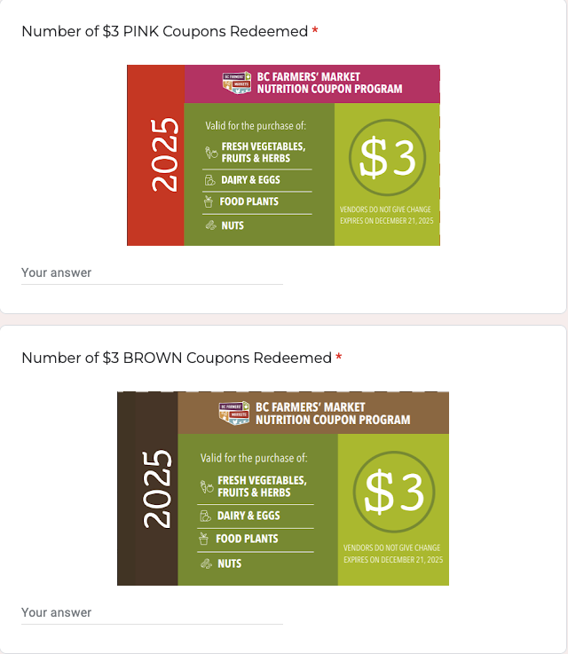
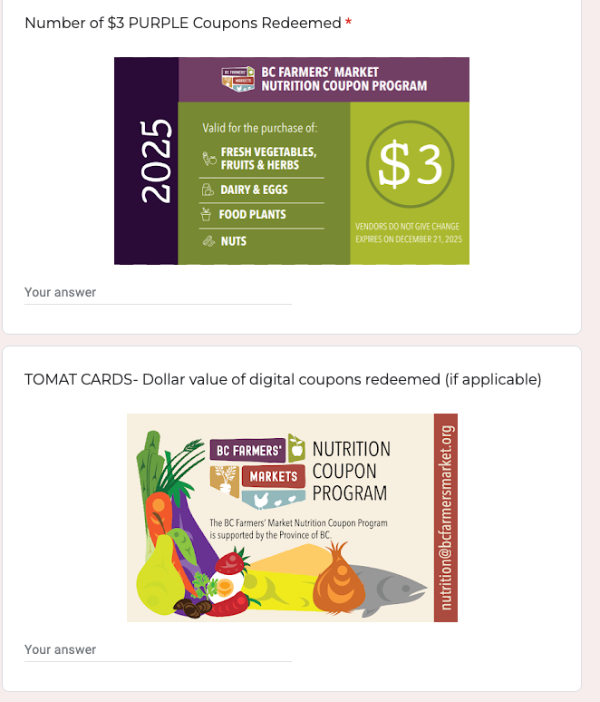
Weekly Reporting
Coming to you via reminder email or find the link on the Program Portal
FARMERS MARKET
Credit: BC Farmers’ Market Trail & Jess Clark
Notes:
My market hasn’t started yet. My market is already over. We found more coupons and have to change the amount. Help!!!!

Slide 22
Follow The Money
FARMERS MARKET
BCAFM Sends Advance $$
VENDOR Accept Coupons
VENDOR Give Coupons to Market
FARMERS MARKET
Reimburses Vendor
FARMERS MARKET
Reports Coupons Weekly
BCAFM Sends Funds When Low
FARMERS MARKET & BCAFM Balance Funding
Notes:
How am I supposed to pay the farmers? Big sacks of cash?

Slide 23
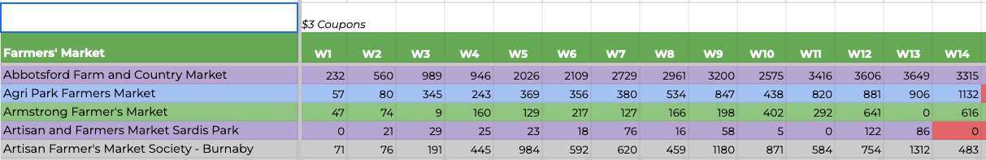
We Know When You Are Low
FARMERS MARKET
Credit: BC Farmers’ Market Trail & Jordan Dyck

Slide 24
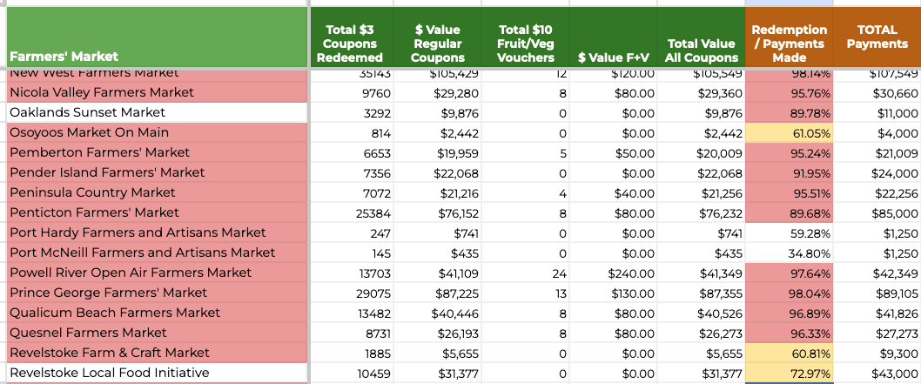
How We Know You Are Low
FARMERS MARKET
Credit: BC Farmers’ Market Trail & Jordan Dyck

Slide 25
FARMERS MARKETS
Your Reports
WEEKLY
Coupons Redeemed Report
ANNUAL
Vendor Report
ANNUAL
Vendor Survey
Credit: BC Farmers’ Market Trail
Credit: BC Farmers’ Market Trail

Slide 26
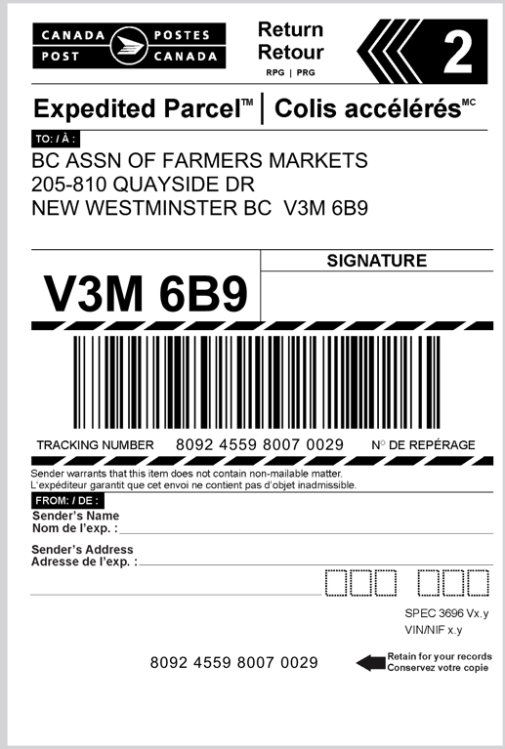

Mail* Coupons to BCAFM
Every Two Months
FARMERS MARKET
June and July | August and September | October and November | December
Mail first week of August | Mail first week of October | Mail first week of December | Mail when market is done or December 21st
Credit: BC Farmers’ Market Trail

Slide 27
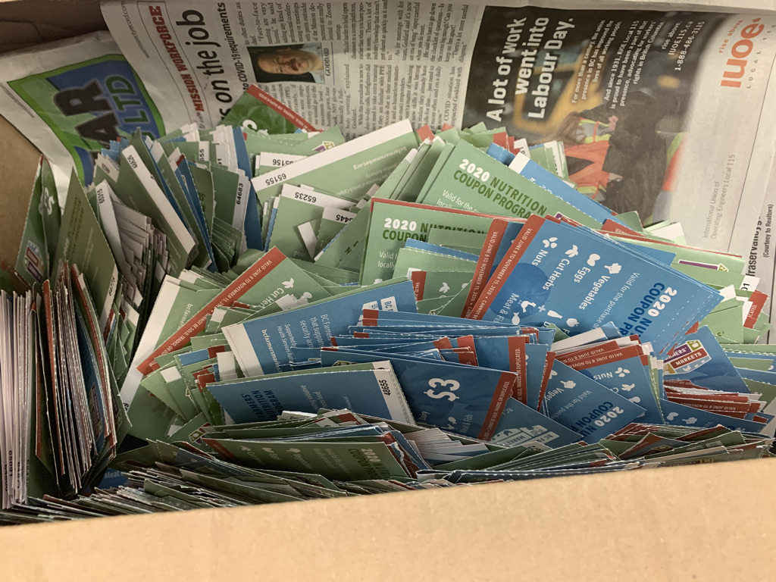
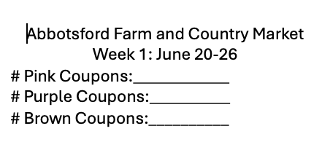
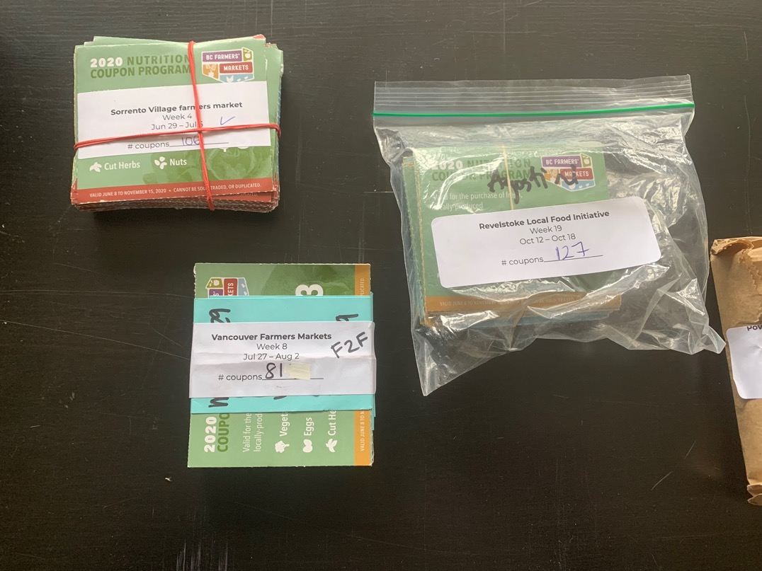
FARMERS MARKET
Bundle coupons by week
and label bundle
Credit: BC Farmers’ Market Trail

Slide 28
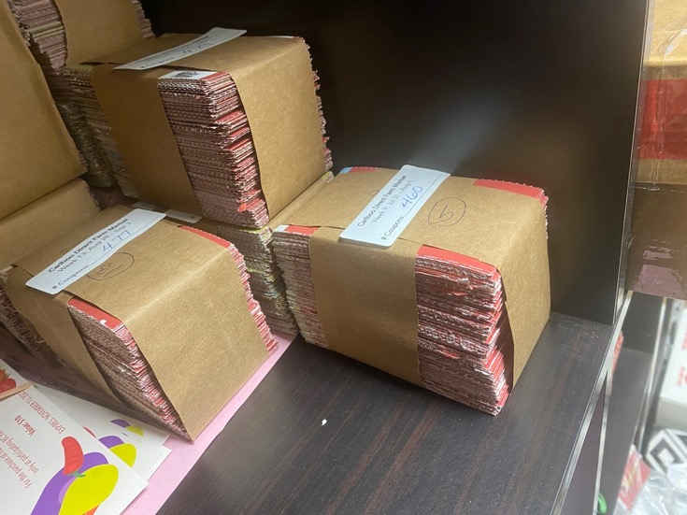
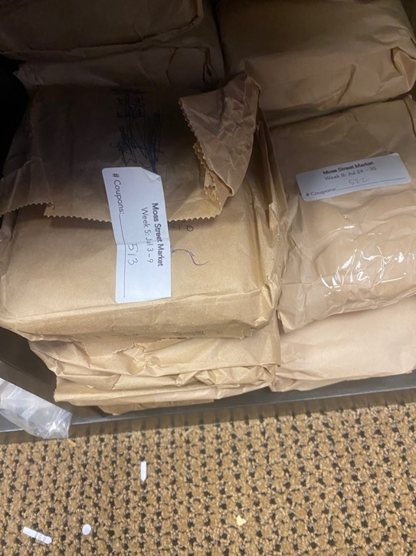
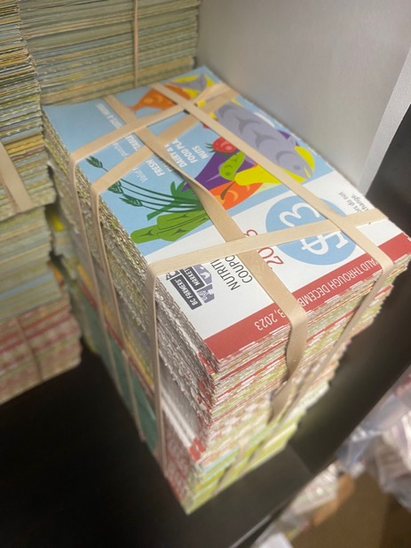
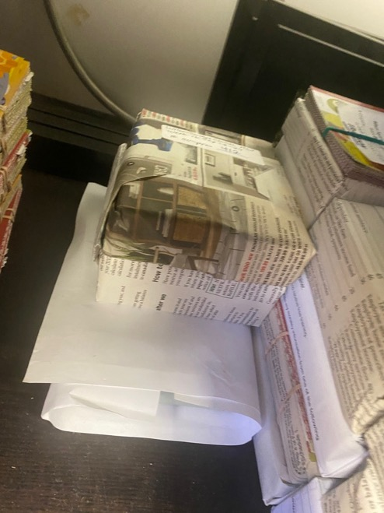
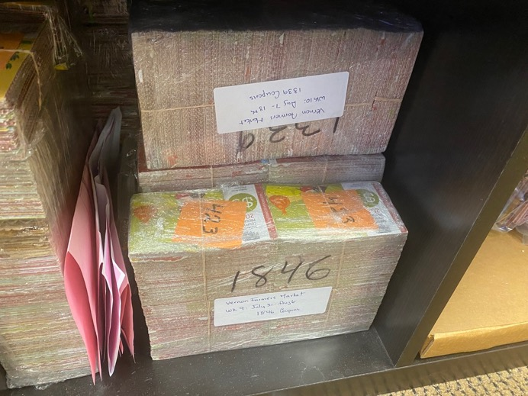
Pack coupons
Credit: BC Farmers’ Market Trail
FARMERS MARKET

Slide 29
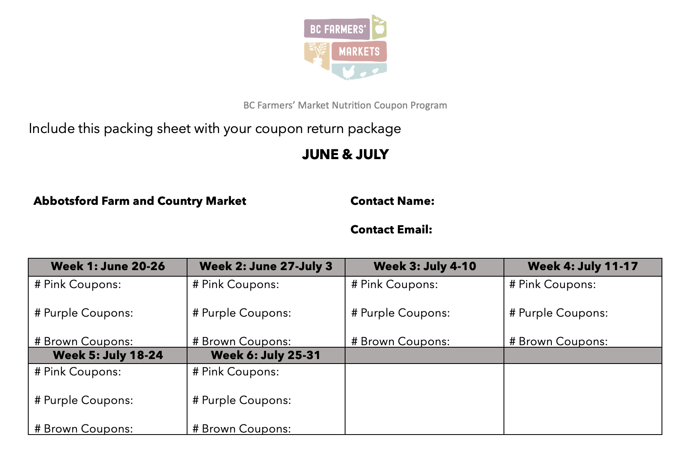
Prepare to mail
Attach prepaid label
FARMERS MARKET
Include packing sheet

Slide 30
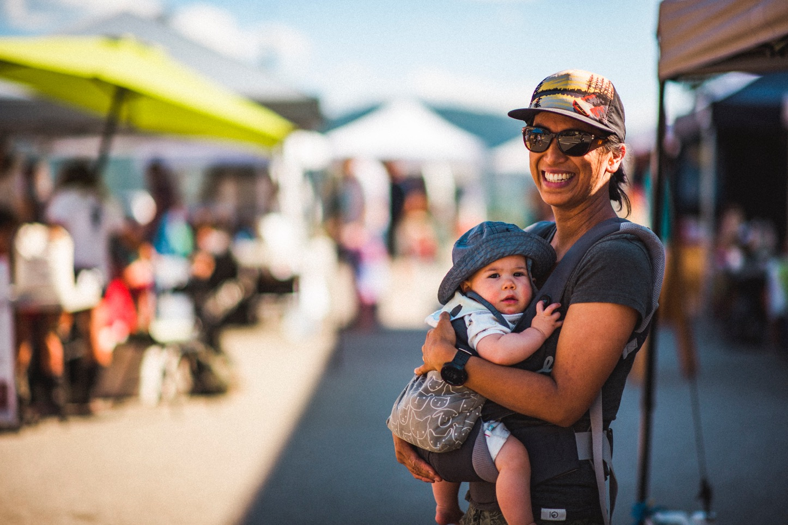
Supporting Participants
PARTNERS
Credit: BC Farmers’ Market Trail

Slide 31
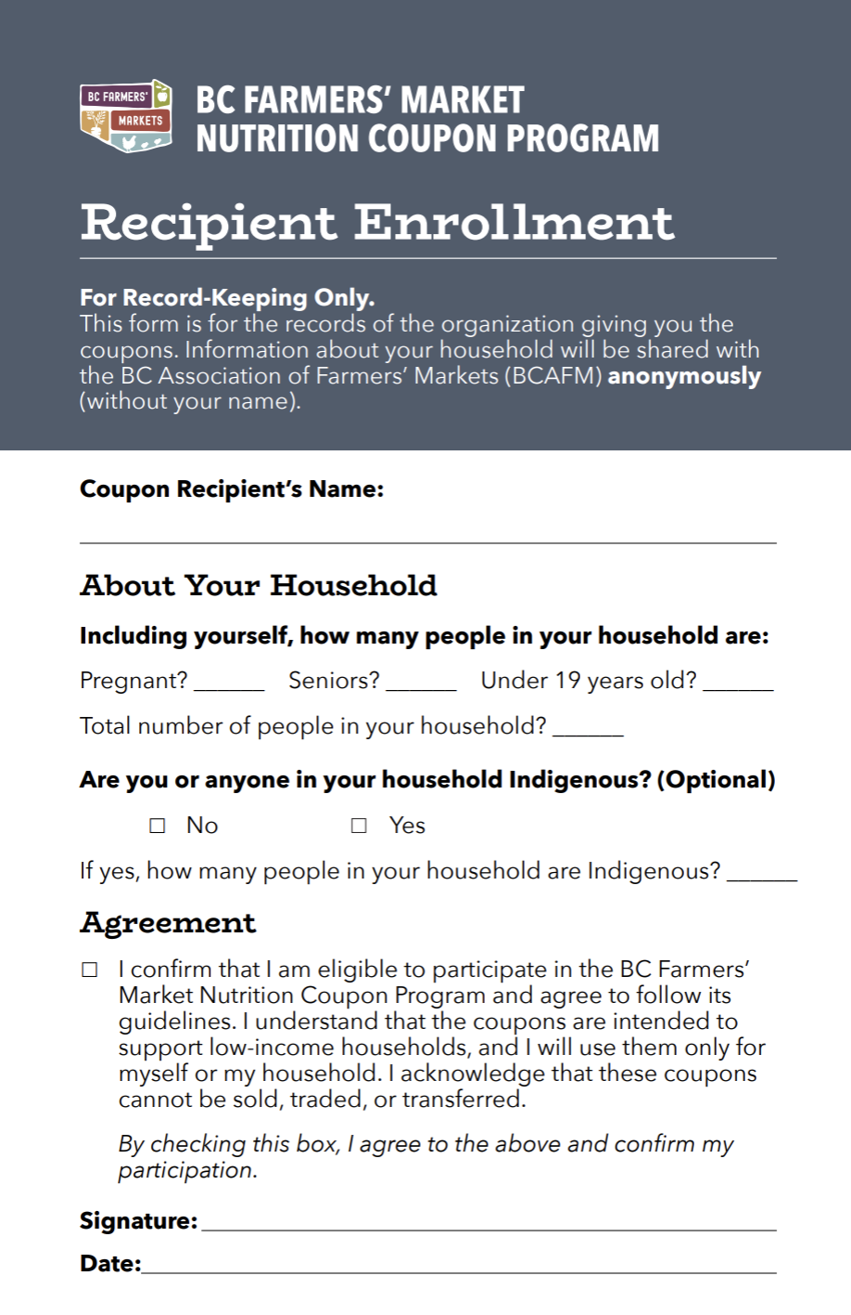
Enroll participants
1 spot = 1 household
1 spot ≠ multiple households
PARTNERS
Credit: BC Farmers’ Market Trail & Jordan Dyck
Notes:
Explain what allocation means

Slide 32
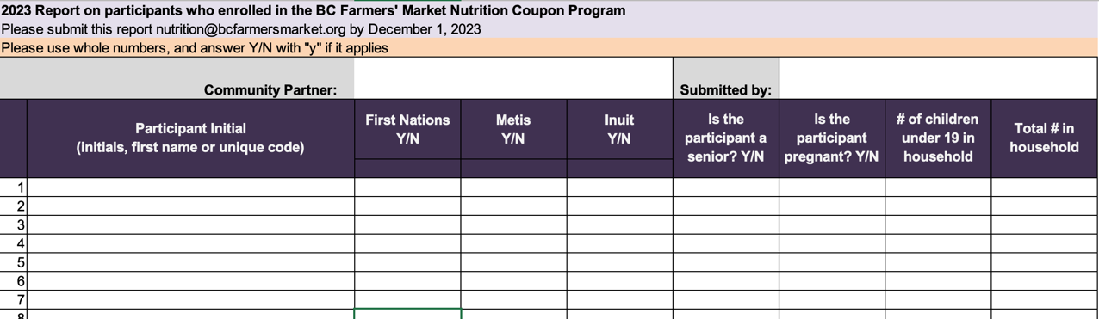
Report to BCAFM – at the end of the program
PARTNERS
Credit: BC Farmers’ Market Trail & Jess Clark

Slide 33
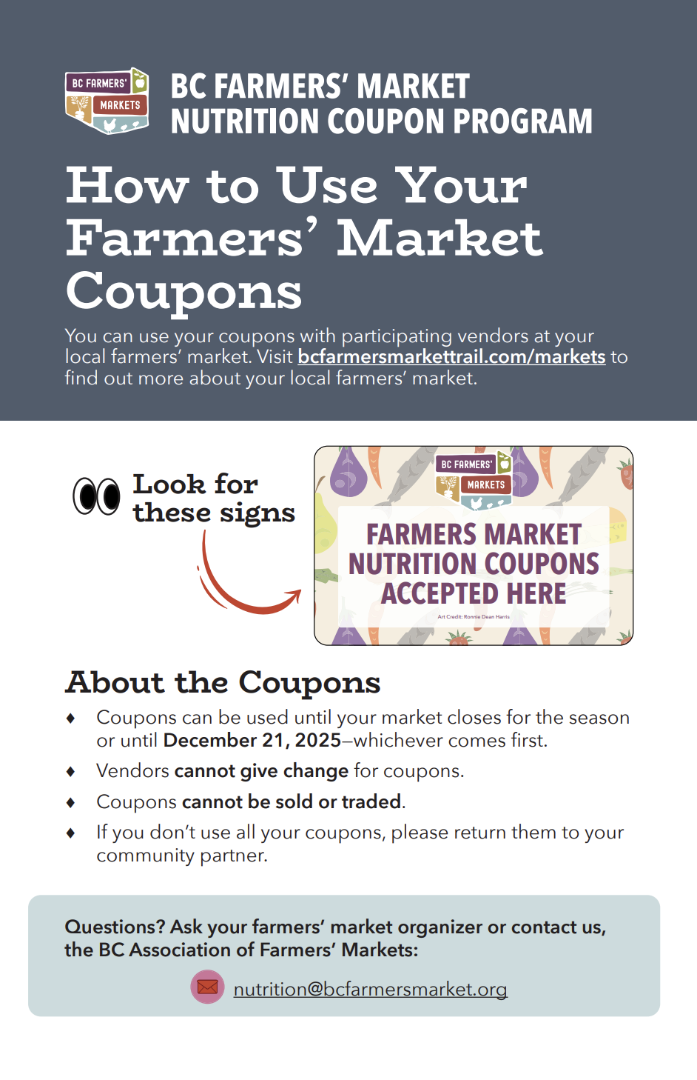
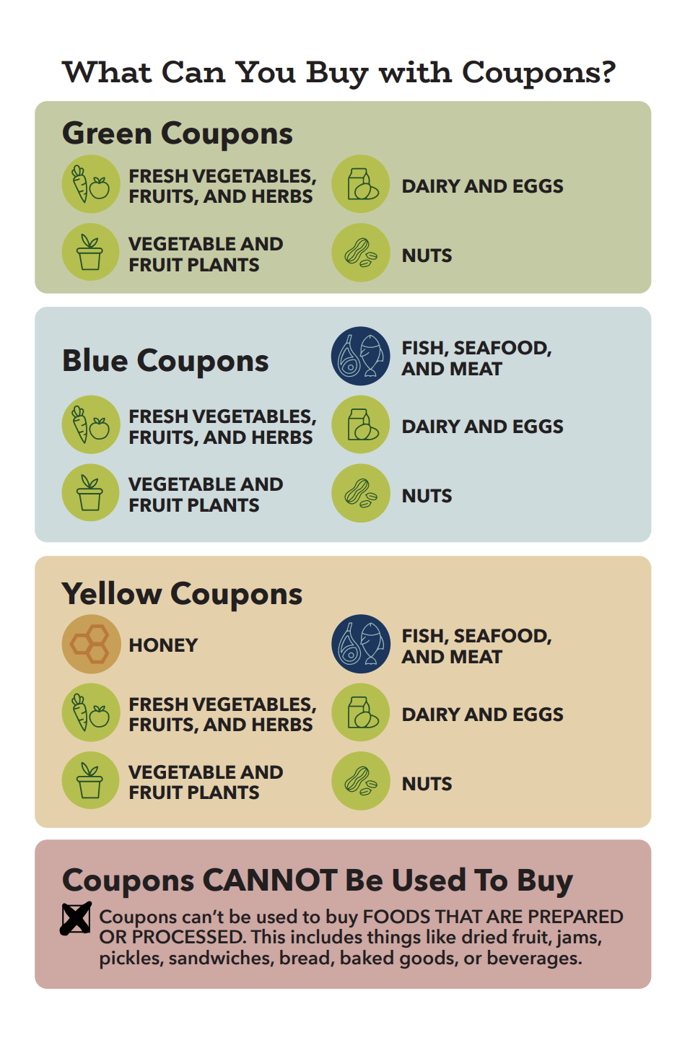
Explain the program to them.
We provide these brochures in English and many other languages
Credit: BC Farmers’ Market Trail & Jess Clark
PARTNERS

Slide 34
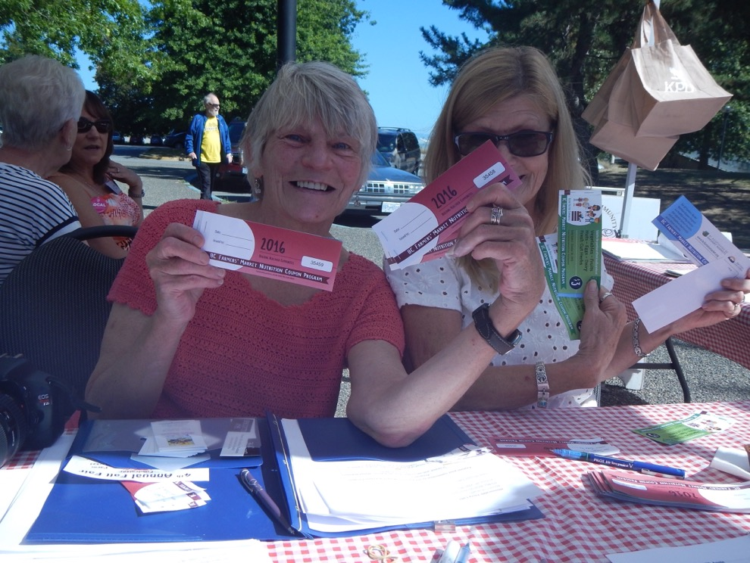
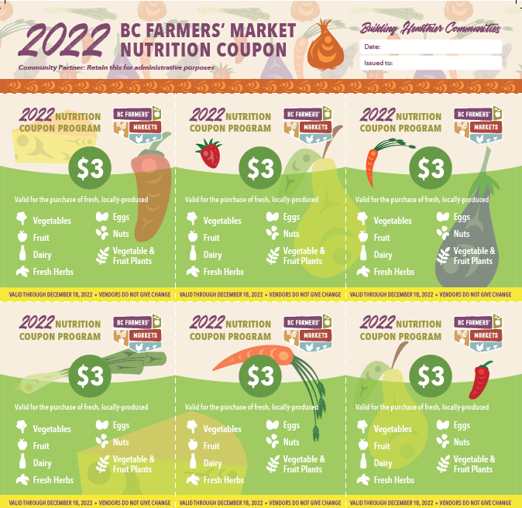
PARTNERS
Distribute Coupons
At regular* intervals.
For 16* weeks
Credit: BC Farmers’ Market Trail & Jordan Dyck
Notes:
Explain the 16 week variations
Explain the regular intervals

Slide 35
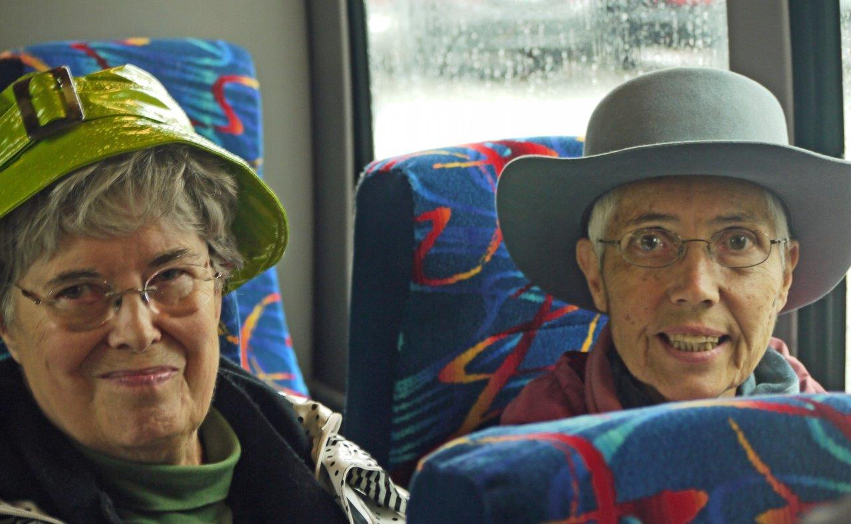
PARTNERS
Check in/Support
Community partner connects with participant to support success, reduce barriers
Credit: BC Farmers’ Market Trail & Jordan Dyck
Notes:
What do you do?

Slide 36
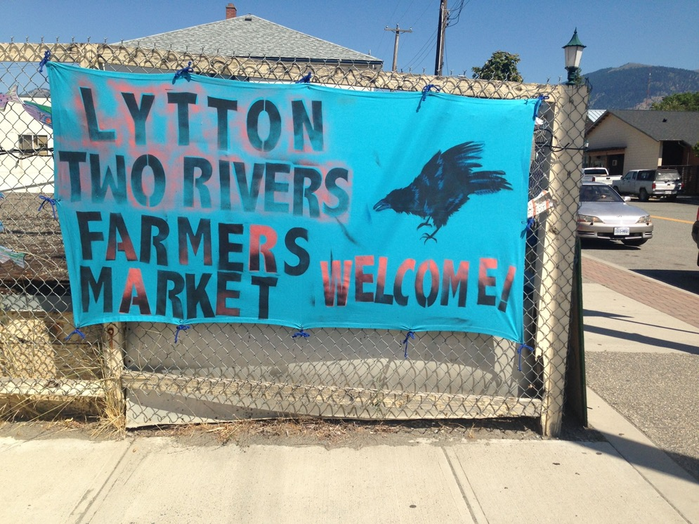
Participant shops at Farmers’ Markets
PARTNERS
Credit: BC Farmers’ Market Trail & Jordan Dyck
Notes:
Talk about collaborating best practices with the markets.

Slide 37
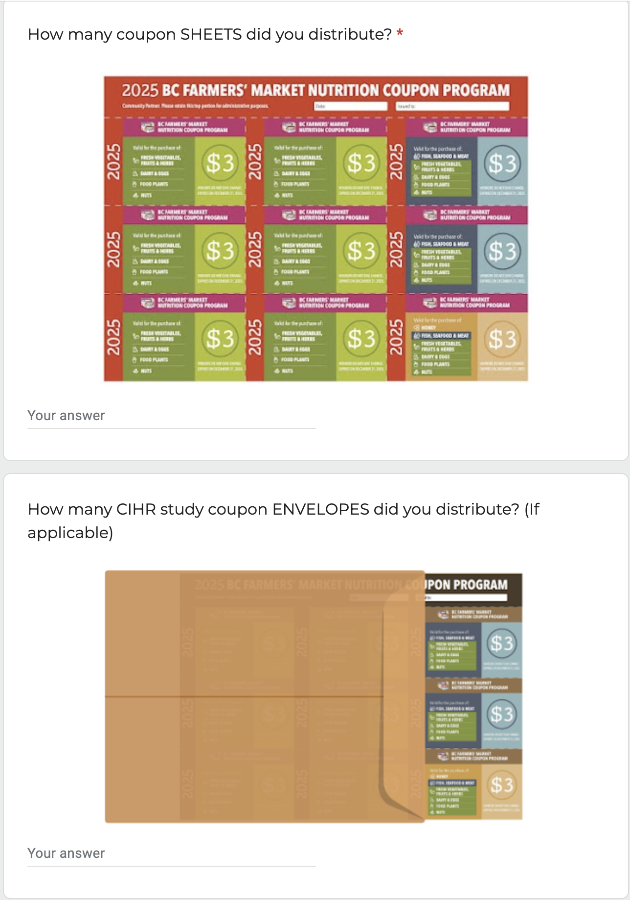
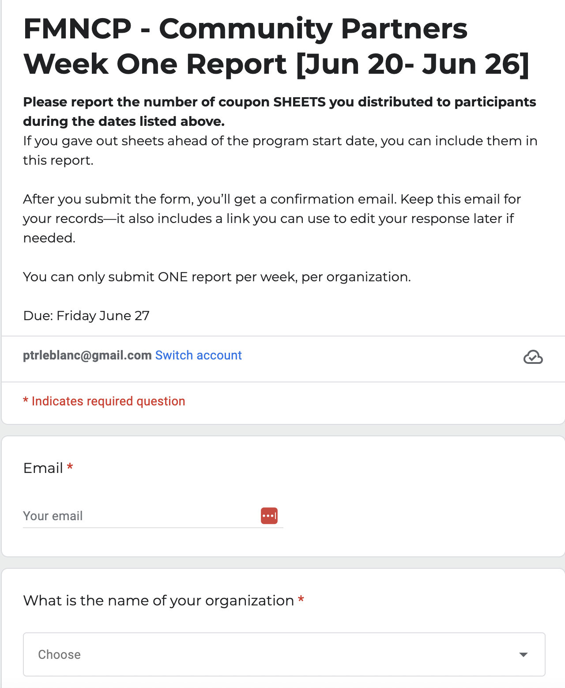
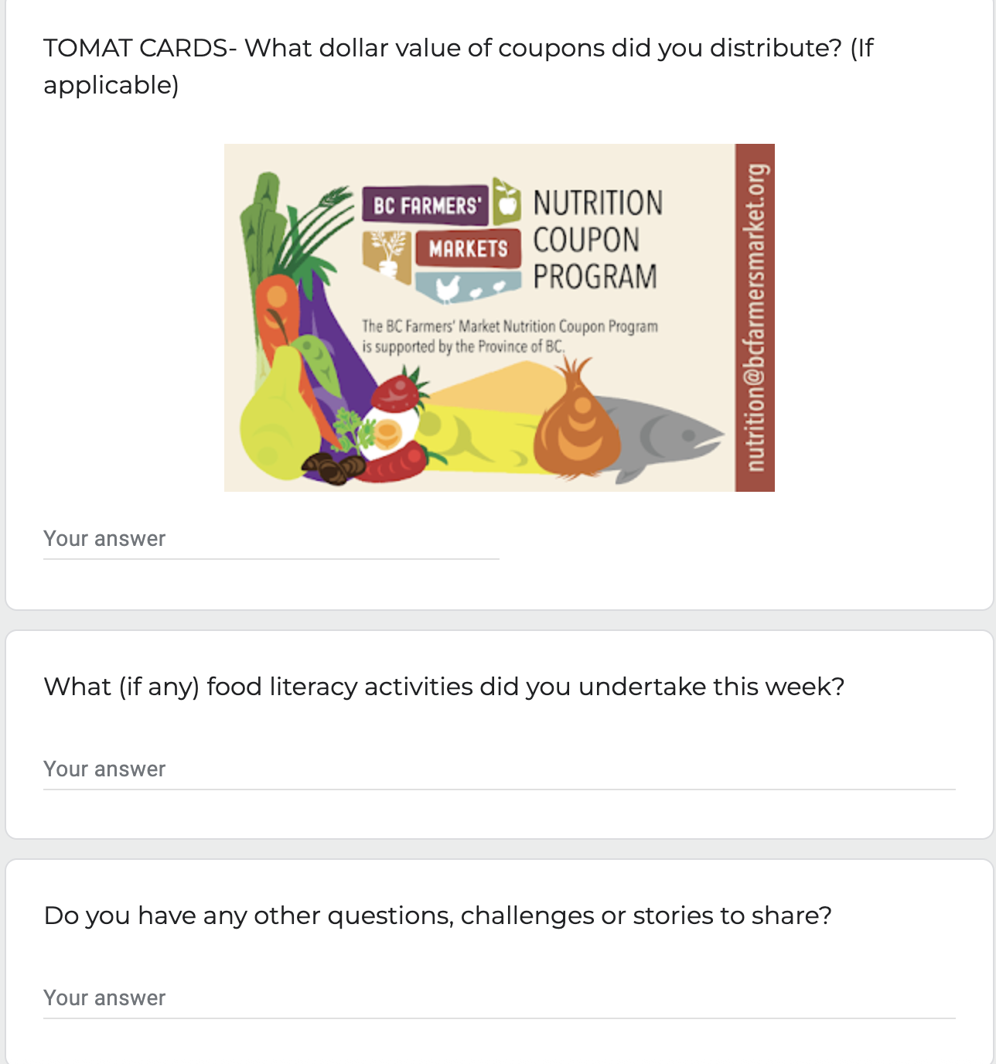
Weekly Reporting
Coming to you via reminder email or find the link on the Program Portal
PARTNERS
Credit: BC Farmers’ Market Trail & Jess Clark
Notes:
My market hasn’t started yet. My market is already over. We found more coupons and have to change the amount. Help!!!!

Slide 38
Two FMNCP Grants Available
Transportation Grant
Up to $300 to support participants getting to the market
Vegetable & Fruit Grant
Up to $100 to buy veggies and fruit from your market for your activities
Notes:
Maybe sprinkle in few examples of what people did to prime the pump.

Slide 39
PARTNERS
Your Reports
EVERY WEEK
Coupon Sheet Distribution Report
ONE TIME
Participant Report
ONE TIME
Participant Survey
Credit: BC Farmers’ Market Trail
Credit: BC Farmers’ Market Trail

Slide 40
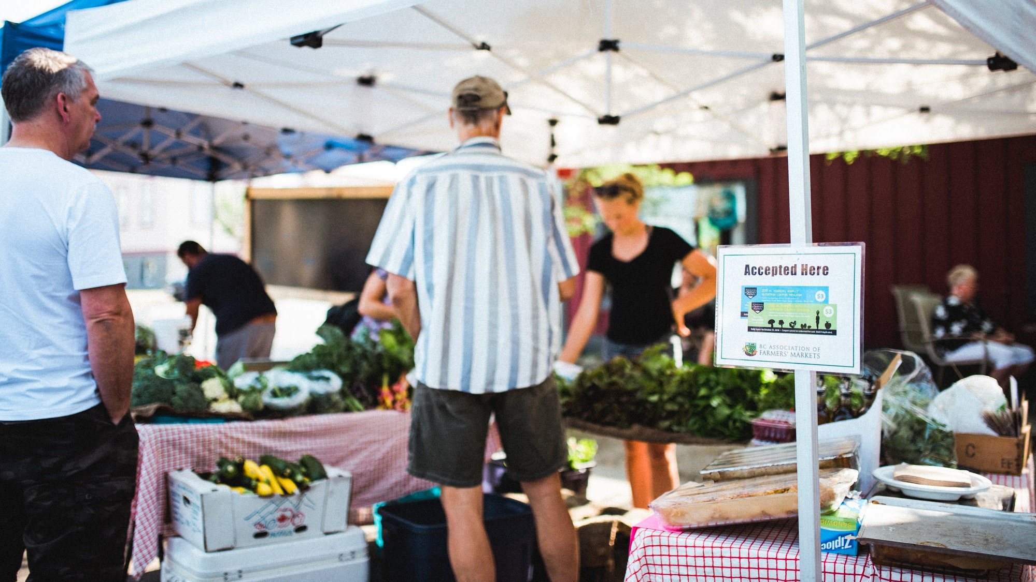
Tools & Resources
Lower Income and Target Populations

Slide 41
TARGET POPULATIONS
Ministry of Health Funded Coupons
Pregnant Persons | The participant should be pregnant at time of enrollment. You can continue to support them for the remainder of the season even if they are no longer pregnant.
Families with Children | Priority is for families with children up to the age of 6, however families with children up to age 19 may be included.
Seniors/Elders | We do not provide an age cutoff to qualify as a senior/elder. Partners are welcome to set their own age cutoff at their discretion or allow people to self-identify.
For allocations that are funded with external funding, recipients must be lower income, but they are not required to be in the target populations, though they may!
Mount Pleasant Farmers Market & Jasmine Noble

Slide 42
Determining Low-Income
It is required for partners to provide these coupons exclusively to lower-income participants.
We do not provide a standardized process such as income-testing to determine eligibility.
We do require your organization to ensure enrolled participants are lower-income through your organization’s own processes.
The process to determine lower-income should be done in a dignified and non-stigmatizing process
PARTNERS

Slide 43
PARTNERS
Within the past 12 months we worried whether our food would run out before we got money to buy more.
Often true
Sometimes true
Never true
Don't know/Prefer not to answer
Within the past 12 months the food we bought just didn’t last and we didn’t have money to get more.
Often true
Sometimes true
Never true
Don't know/Prefer not to answer
Mount Pleasant Farmers Market & Jasmine Noble

Slide 44

for 2025
TOMAT Pilot in Sicamous & Pender Island
CARD
CIHR Study by the University of Calgary at Alberta
BROWN
UBC Research Project
Feeding Futures
PURPLE
Accessibility Project

Slide 45
for 2025
CIHR Study by the University of Calgary at Alberta
Study Objective
Understand FMNCP’s impact on family wellbeing
Determine optimal coupon amount for diet quality and food security
About the Study: We are inviting 276 parent-child pairs who are part of FMNCP
1 parent/caregiver and 1 of their children (6-12 years and may expand to 17 years old) who live together at least 5 days/week
Families will be randomized to 1 of 3 groups. Each family will get either $27/week or 2x or 3x in sealed envelopes.
Participants will be asked to complete an online survey and dietary recalls. Participation is voluntary. Participants can get up to $360 in a gift card if they complete all data collection steps.
Blinded study: No one, including partners, BCAFM staff, and the research team, can know how many coupons participants get. Only the participant and the person packaging the coupons can know.

Slide 46
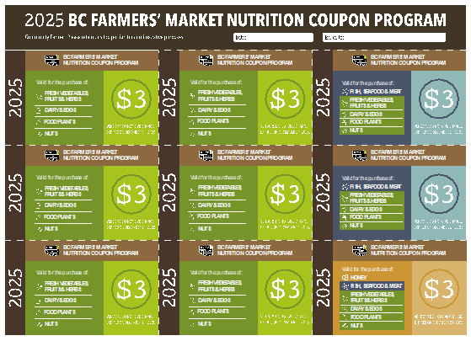
for 2025
CIHR Study by the University of Calgary
Community Partners’ role:
Invite participants that you think fit the study criteria and complete the pre-screening survey
Distribute coupons in sealed envelopes to selected participants
Record when participants get their envelopes and when they attended nutrition skill-building activities (if any)
Farmers Markets’ role:
Orient vendors to accept the coupons
Separately report, bundle and mail coupons just like the Ministry of Health Coupons
Contact:
A research team member will be in contact with you soon (if not already!) to tell you more about the study

Slide 47

ish
for 2025
Feeding Futures
Some BC Schools Will Issue Coupons to students
Farmers Markets’ role:
Orient vendors to accept the coupons
Separately report, bundle and mail coupons
Participating Communities
Squamish, Whistler, Pemberton
Invermere, Golden, Kimberley
Vanderhoof, Burns Lake
Penticton (digital card)

Slide 48

for 2025
Digital Card Pilot in Sicamous ,Pender Island and Penticton
Notes:
Add the new language from TOMAT for their credit

Slide 49

for 2025
Accessibility Project
With the support of a Canada Summer Job’s Funded Student:
Share this toolkit with farmers markets & vendors
Conduct audits
Support farmers markets and vendor to improve accessibility.

Slide 50

for 2025
UBC Research Project Why Farmers Leave Farmers Markets
A project by UBC students in the Masters of Food and Resource Economics Program
Survey of why farmers stopped selling at a farmers’ market
Share learnings and improve the farmers market experience for farmers

Slide 51
6 Regional Coordinators
    The Interior, Mandy Drescher
    Kootenay/Columbia Basin, Courtney Mastine
    Fraser Valley and Metro Vancouver, Monica Grover
    The North and Cariboo, Jutta Schoenhardt
    Vancouver Coastal, Emily Lorenz
    Vancouver Island and Gulf Islands, Kerri Fulop
Notes:
Change to Keynote

Slide 52

Tools & Resources
Credit: BC Farmers’ Market Trail & Thomas Nowaczynski

Slide 53

Program Portal – your 24/7 concierge

Slide 54
In the Portal
For Farmers Markets
Weekly Reports - Hot Links
Vendors (who accept coupons) brochure
Other Vendors (who don’t accept coupons) brochure
Vendor enrollment form
Vendor Report for BCAFM - excel

Slide 55
In the Portal
For Community Partners
Weekly Reports - Hot Links
Participant Brochures, English and 12+ other languages
Participant enrollment form
Participant Report - excel
Recipes and activities

Slide 56



2025 BCAFM Membership Update
Photo Credit: BC Farmers’ Market Trail & Johann Vincent

Slide 57


Membership Questions?
Contact your Regional Coordinator or any of our team below:
Melissa Maltais Membership & Programs Manager melissa@bcfarmersmarket.org Membership Issues Questions/Concerns Farmers’ Market Resources | Jasmine Houle Marketing & Stakeholder Engagement jasmine@bcfarmersmarket.org BCAFM Benefit Partner Questions Media & PR Features Farmers' Market Trail Stories
Stacey Santos Grant Administrator & Senior Support stacey@bcfarmersmarket.org BCAFM Grant Support (non-FMNCP related grants) Resources & Toolkits Support | Jocelyn Cheung Membership & Marketing Coordinator jocelyn@bcfarmersmarket.org Sharing Social Media Posts Access to Photo Bank & Logos Changes to Email Lists (non-FMNCP related email lists)
Finn Powers Administrative Support projects@bcfarmersmarket.org General info@ Questions Updates to BC Farmers’ Market Trail
BC Farmers’ Market Trail & Johann Vincent

Slide 58
2025 BC Farmers' Market Summer Marketing Campaign
3 NEW videos being filmed this summer to promote BC Farmers' Markets
1
Press release to all media to encourage people to "Travel Local, Eat Local" and "Taste BC Like Never Before"
2
30 second commercial promoting farmers' markets on television networks
3
Written stories on BC Farmers' Market Trail
4
Social Media (Meta) ads designed and loaded up for boosting
5
Digital ads on Glacier Media and Post Media websites
6
Printed ads for Transit (in bus) campaign
7
Influencer program underway
8
Partnership with 14 Destination Marketing Offices across the Province
9
Email marketing campaign planned to our subscriber list
10
We emailed all the Featured Tour points of interests stops to let them know folks can check in with them
11
We emailed all our market members to go over our summer campaign!
12
We created social media graphics, and a poster for you to share
13
Vinyl “Check In here” Decals being shipped to Farmers' Market Members and Featured Tour Stops
14
Added new 2025 BC Farmers’ Market Summer Challenge to the App
15
In collaboration with Destination BC and as a recipient of a Co-op Marketing Funding we have set up the following marketing tactics to promote our farmers' market members this summer!

Slide 59
And wait... there's more!
We also received a BuyBC grant!
  Printed 120,000 "Taste BC Like Never Before" rack cards with the goal of mailing out 40,000 each year over the next three years
  Mailed rack cards to all the Tourism Info Centers around the Province
  Mailed rack cards to all our farmers' market members – they are on their way!
  Added our BCAFM rack cards to 7 popular BC Ferries routes
  We were able to get funding for 3 more influencer partnership videos

Slide 60
SAVE THE DATE – 2026 BC Farmers' Market Conference
Celebrate 25 years of BCAFM with us!
Our conference will be held in beautiful North Vancouver from Friday March 6th to Sunday March 8th, 2026.
We are looking for speakers from our farmers' market membership. Got a cool program you're running at your market? Are you rocking social media?
Visit bcfarmersmarket.org website to submit your workshop idea!
To be held at the Pinnacle at the Pier in North Vancouver!

Slide 61
Win An All Inclusive BCAFM Conference Pass!
AND a one night's stay at the Pinnacle at the Pier!
The BC Farmers' Markets member market that has the MOST check ins on the BC Farmers' Market Tasting Passport App from June 15th to September 15th will win this amazing prize!
To keep things fair, we’ll be calculating check-ins relative to your visitor counts from your 2023 Economic Impact Study. We’re working on the mathing so everyone has a fair shot at a FREE conference ticket!
Make sure your App listing is up to date and is working!

Slide 62

Thank You!
Contact Us
nutrition@bcfarmersmarket.org
604-734-9797
bcfarmersmarket.org
bcfarmersmarkettrail.com
Follow Us
@bcfarmersmarket
@BCAFM
Surrey Urban Farmers Market & Johann Vincent

